Slide 1

PRICING MODEL FOR BIG MOUNTAIN RESORT

Slide 2
THE PROBLEM
Big Mountain resort has recently installed an additional chair lift that increases their operating costs by $1,540,000 per season.
Based on this change, they would have to change their ticket price.
In the past, they would just base their price on the market average of resorts without factoring in all the facilities they provide.
With my model, we can find out how Big Mountain should be priced and why

Slide 3
KEY FINDINGS AND RECOMMENDATIONS
The Model had a mean average error of $9.5 and explained 71% of the variance in price.
It predicted Big Mountain resort should have a price of $95.87 compared to its current price of $81.
The chance of the model being wrong by $14.87 is 0.1% and so an increase in price is most likely justified
The data does not account for number of visitors

Slide 4
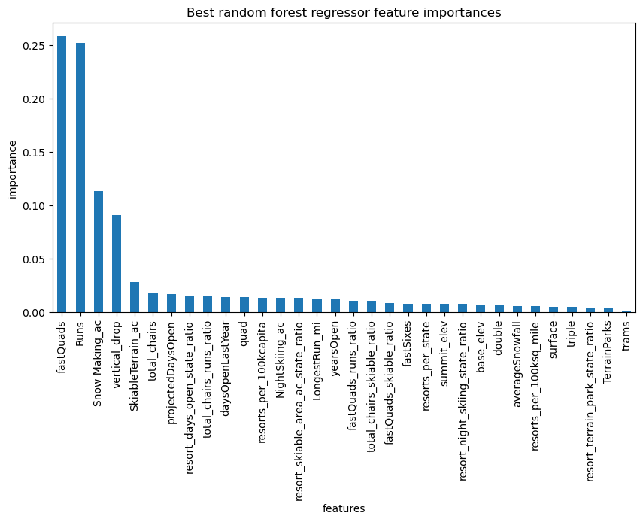
What affects price most?

Slide 5
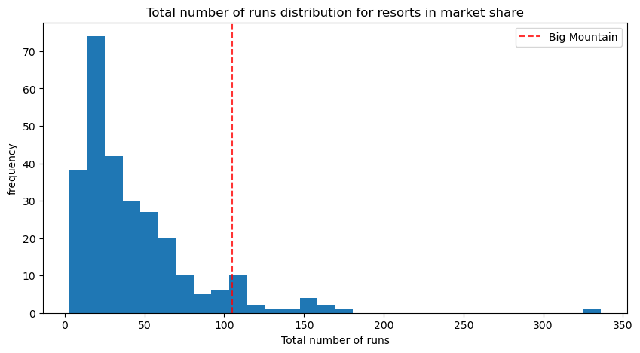
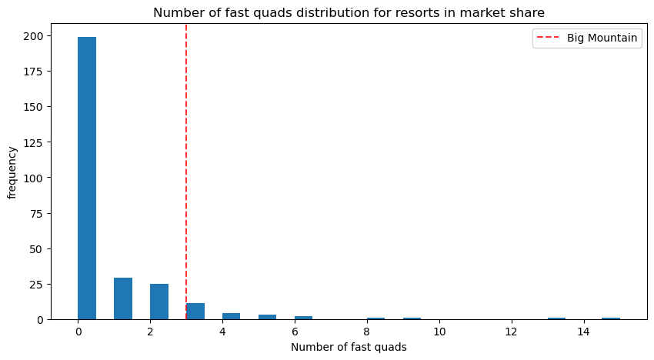
Big Mountain seems to be way above average in factors that are most important in predicting price.

Slide 6
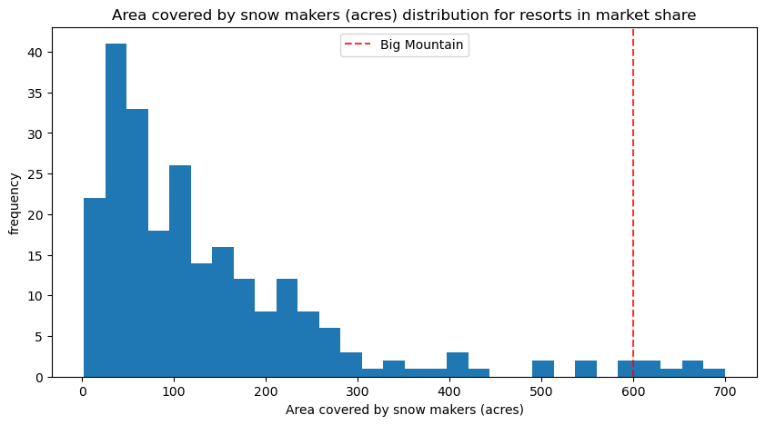
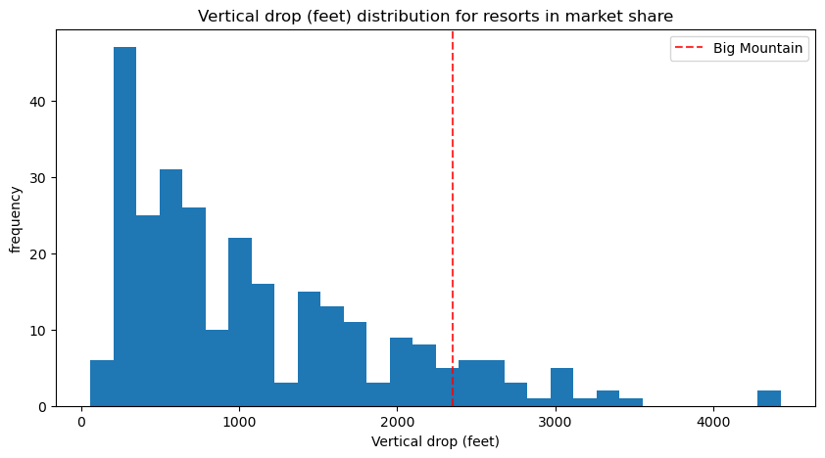
Big Mountain seems to be way above average in factors that are most important in predicting price.

Slide 7
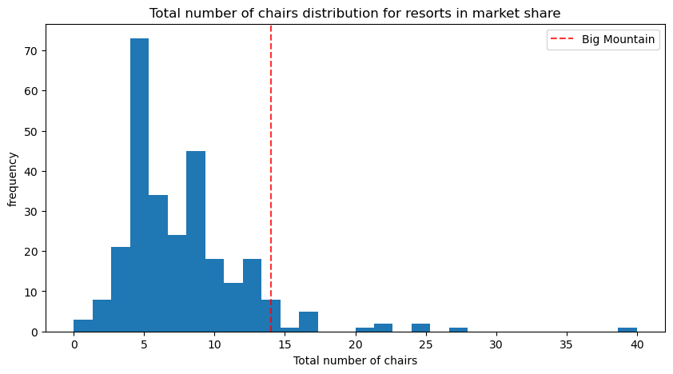
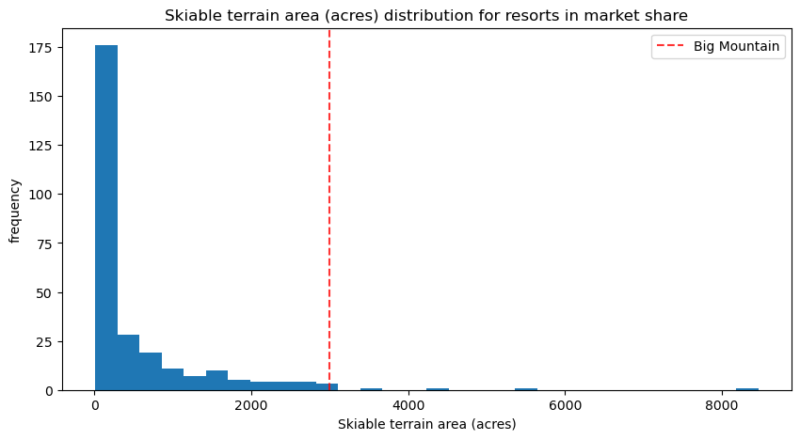
Big Mountain seems to be way above average in factors that are most important in predicting price

Slide 8
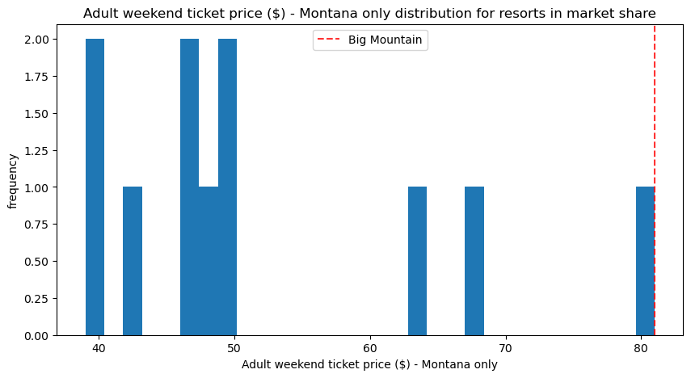
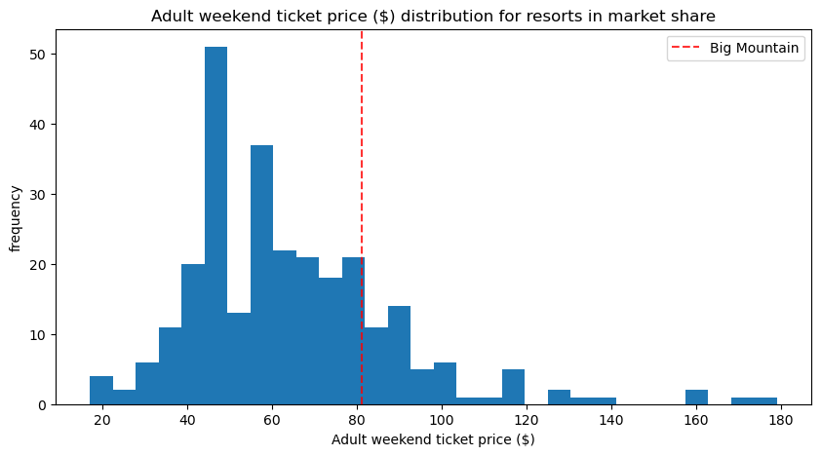
While Big Mountain may be the most expensive resort in Montana, it is only slightly above average when compared to the whole market

Slide 9
SUMMARY
Big Mountain Resort is currently heavily underpriced.
Fast Quads, Runs, Snow making ac, Vertical Drop, Skiable Terrain and total chairs are the most important factors in affecting price.
The model can help inform future decisions on changes in facilities or price.
Recommendations from this model should be approached cautiously as number of visitors was not factored in.

